Slide 1
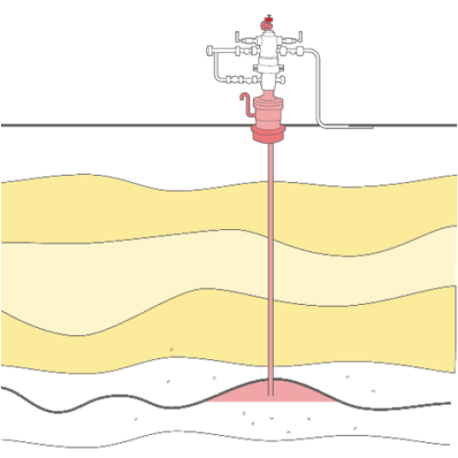


Slide 2


Slide 3




ALN R
ALNOOR
ALN R

Slide 4
ALN R

